Slide 1
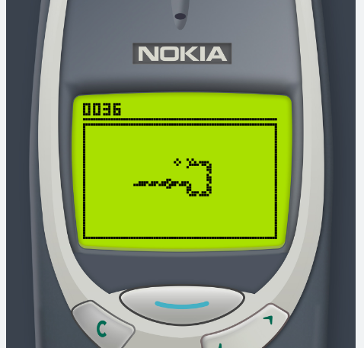
Snake game using Reinforcement Learning
PRESENTED BY:
JITENDRA PRASAD KADIYAM
RAMANA BELAMKONDA

Slide 2
PROJECT OBJECTIVES:
Implement Snake Game Environment: Define the mechanics of the snake game environment, specifying grid size, starting position of the snake, and rules for generating food. Develop a Python script that encapsulates the game environment and its functionalities.
Integrate Reinforcement Learning (RL):Implement reinforcement learning to enable the snake (agent) to learn and adapt its behavior in the game environment. Utilize the Q-learning algorithm, a popular RL algorithm suitable for environments with discrete state and action spaces.
Design and Train Deep Neural Network (DNN):Develop a Deep Neural Network using the Py-Torch deep learning framework.
Performance Metrics and Evaluation: Define performance metrics such as average reward per episode, length of survival, and convergence of the Q-value function. Evaluate the snake's performance through visual inspection, comparing its behavior at different stages of training.
Comparison and Analysis: Compare the performance of the RL agent with potential baselines, such as random actions or basic heuristics. Analyze learning curves and convergence patterns to ensure the stability and effectiveness of the training process.
By achieving these objectives, our project aims to create an intelligent and adaptable snake agent through reinforcement learning and demonstrate the successful integration of deep neural networks for decision-making in a customized game environment.

Slide 3
APPROACH:
Environment Setup:
Use Python for coding the project.
Utilize Py-Torch for deep learning implementation.
Develop the game environment (snake game) in Python.
Deep Neural Network:
Implement a Deep Neural Network with Py-Torch.
Design the network architecture with 11 input layers, 256 hidden neurons, and 3 output layers.
Use the Re-Lu activation function for the final layer.
Train the neural network to predict actions based on the game state.
Q-Learning Algorithm:
Implement the Q-learning algorithm for reinforcement learning.
Initialize the Q-value function for state-action pairs.
Utilize an epsilon-greedy policy for action selection.
Update the Q-value function iteratively based on observed rewards and transitions.

Slide 4
APPROACHES- Reinforcement Learning
Reinforcement learning is a type of machine learning that enables an agent to learn in an environment by trial and error using feedback from its own actions and experiences.
In RL, there are two components, that are environment( which is our game) and the agent (snake which is in the environment).
Every time the agent performs an action, the environment gives a reward to the agent, which can be positive or negative depending on how good the action was from that specific state.

Slide 5
APPROACHES- SNAKE GAME ENVIRONMENT
We are defining the mechanics of the game such as grid’s size, the starting position of the snake which is half of height and width of the grid size, and the rules for generating food.
We are defining the game’s environment in game.py file, and we are defining the rules to move the agent around the environment that is to move either left,right,up or down.
Placing the food in the environment once it’s consumed the old food.
If there is any collision occurring to any of the grid boundaries or hitting itself.
Also playing the step which is gathering input from the user which can be either from RL agent or human, to move the snake along the grid.

Slide 6
APPROACHES- Deep neural network dnn
We are training a Deep Neural Network model using py-torch deep learning framework for our project.
It consists of 11 input layers with 256 neurons which are hidden, and output size is 3 layers.
The network receives as input the state, and returns as output three values related to the three actions: move left, move right, move straight( which can be up and down).
We are using RELU(Rectified Linear Unit) activation function for the last layer of the neural network.
Once the network is trained, we are saving the model in the same directory as the python file.

Slide 7
APPROACHES- Q Learning algorithm
We are using Q-learning, which is a popular reinforcement learning algorithm used for environments with discrete state and action spaces.
The algorithm uses the Q-value function, which estimates the expected cumulative reward for taking an action in a given state and following the optimal policy thereafter.
The Q-value function is updated iteratively based on the observed rewards and transitions.
Steps:
Initialize the Q-value function randomly for all state-action pairs.
Repeat until convergence or a maximum number of episodes:
Observe the current states.
Select an action a based on an epsilon-greedy policy.
Take the action a and observe the reward r and the next state s'.
Update the Q-value function.
Set the current state to next state s’.
Return the learned Q-value function.

Slide 8
DELIVERABLES:
Game Environment Code:
Submission of the Python code for the game environment (game.py).
Clear documentation explaining the mechanics, rules, and user input handling.
Deep Neural Network Model:
Provide the trained Deep Neural Network model file.
Include a script or notebook detailing the training process.
Q-Learning Implementation:
Share the Python script implementing the Q-learning algorithm.
Documentation explaining the Q-learning steps and parameters

Slide 9
EVALUATION METHODOLOGY
Performance Metrics:
Evaluate the performance based on the snake's ability to survive and accumulate rewards.
Track metrics such as average reward per episode, the length of survival, and convergence of the Q-value function.
Visual Inspection:
Provide a visual representation of the snake's gameplay.
Display the snake's movements and decision-making during different stages of training.
Comparison with Baseline:
If applicable, compare the performance of the RL agent with a baseline, such as random actions or a basic heuristic.
Convergence Check:
Check for convergence of the Q-value function by monitoring changes over episodes.
Analyze learning curves and ensure stability in the learning process.
User Interaction:
Allow users to interact with the trained snake for additional qualitative evaluation.
Gather feedback on the responsiveness and adaptability of the snake's behavior.

Slide 10
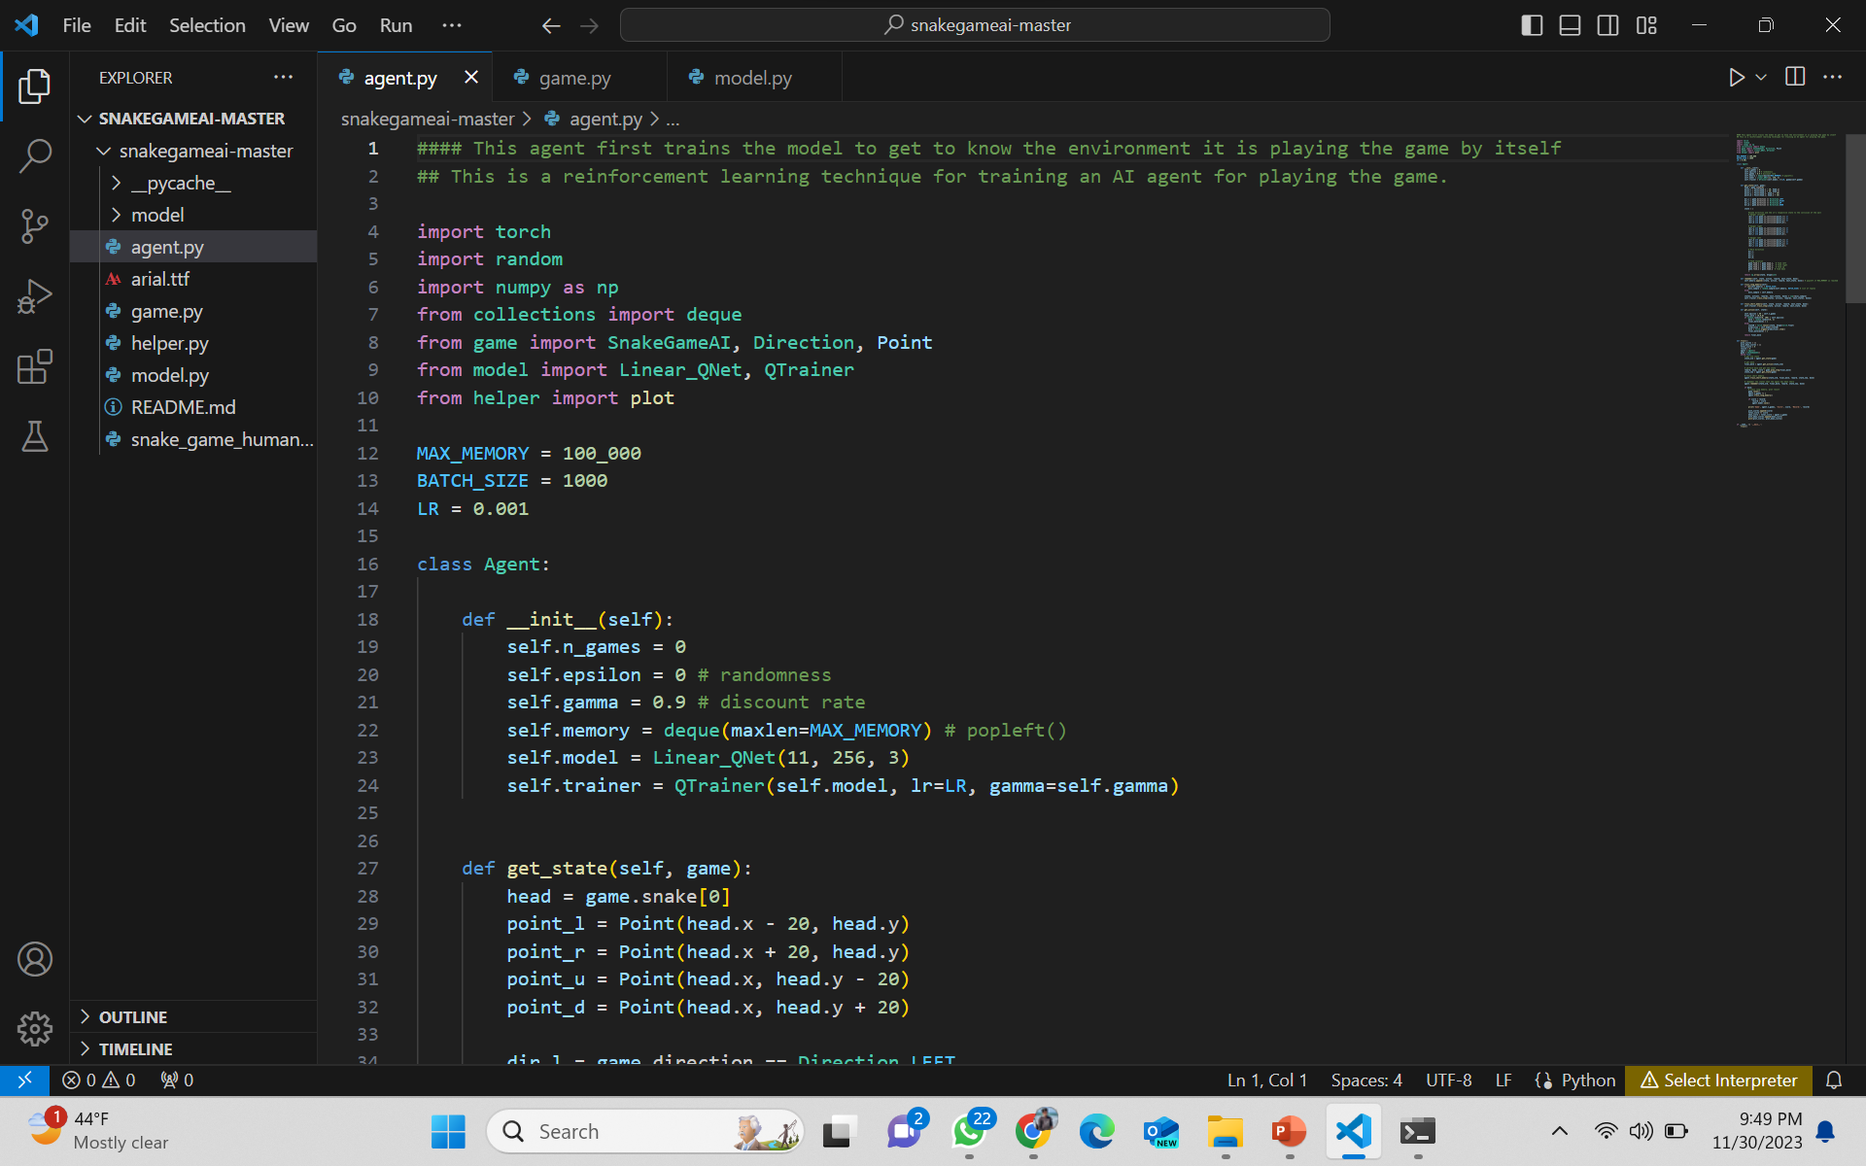
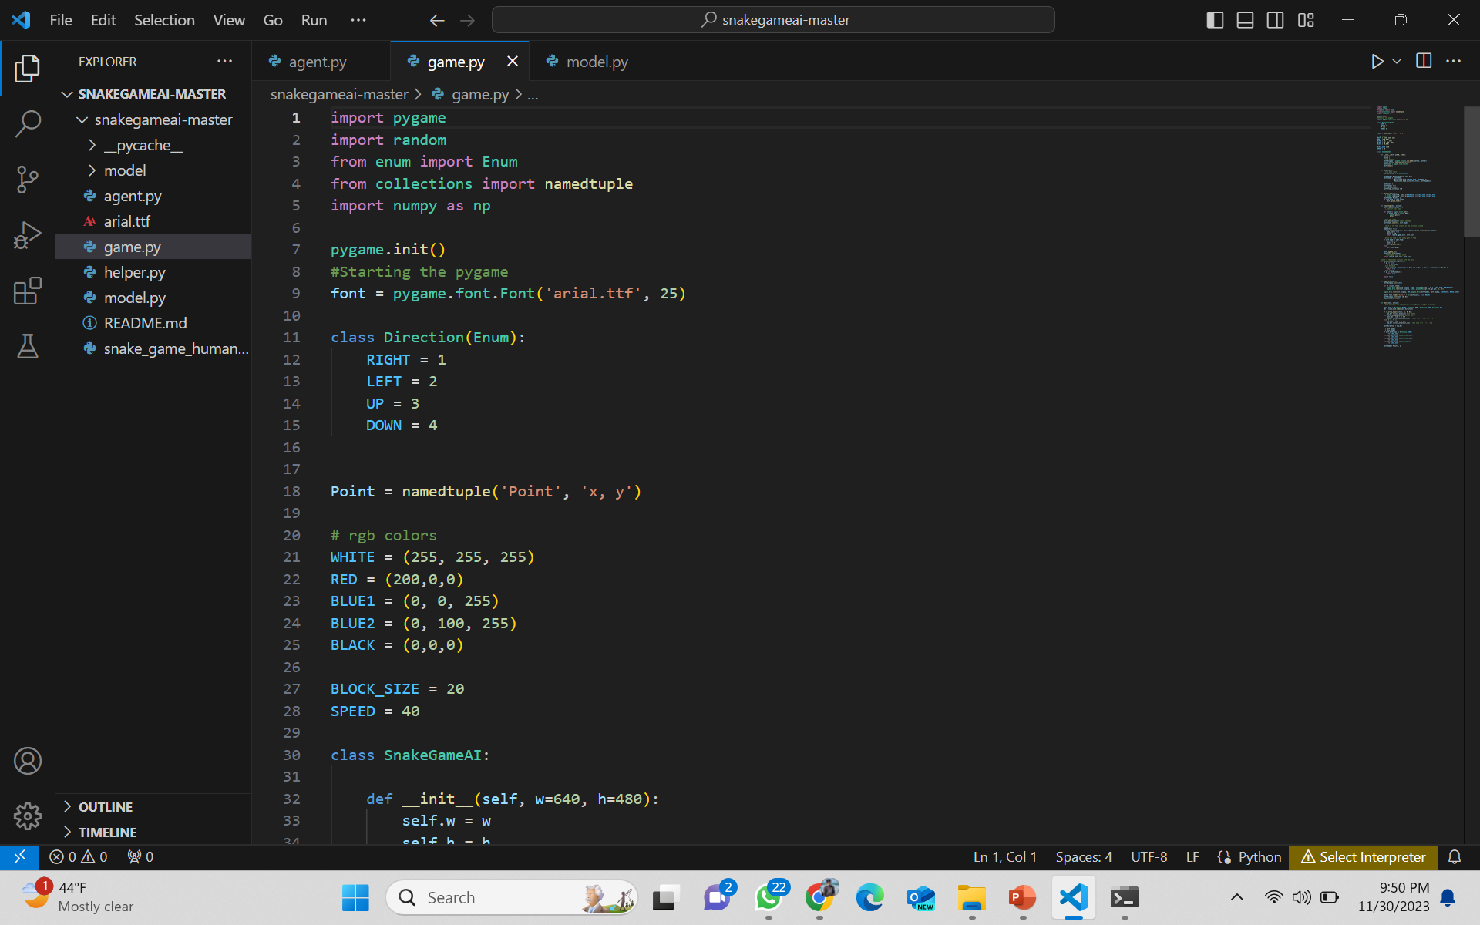
WORKING MODEL- CODE

Slide 11
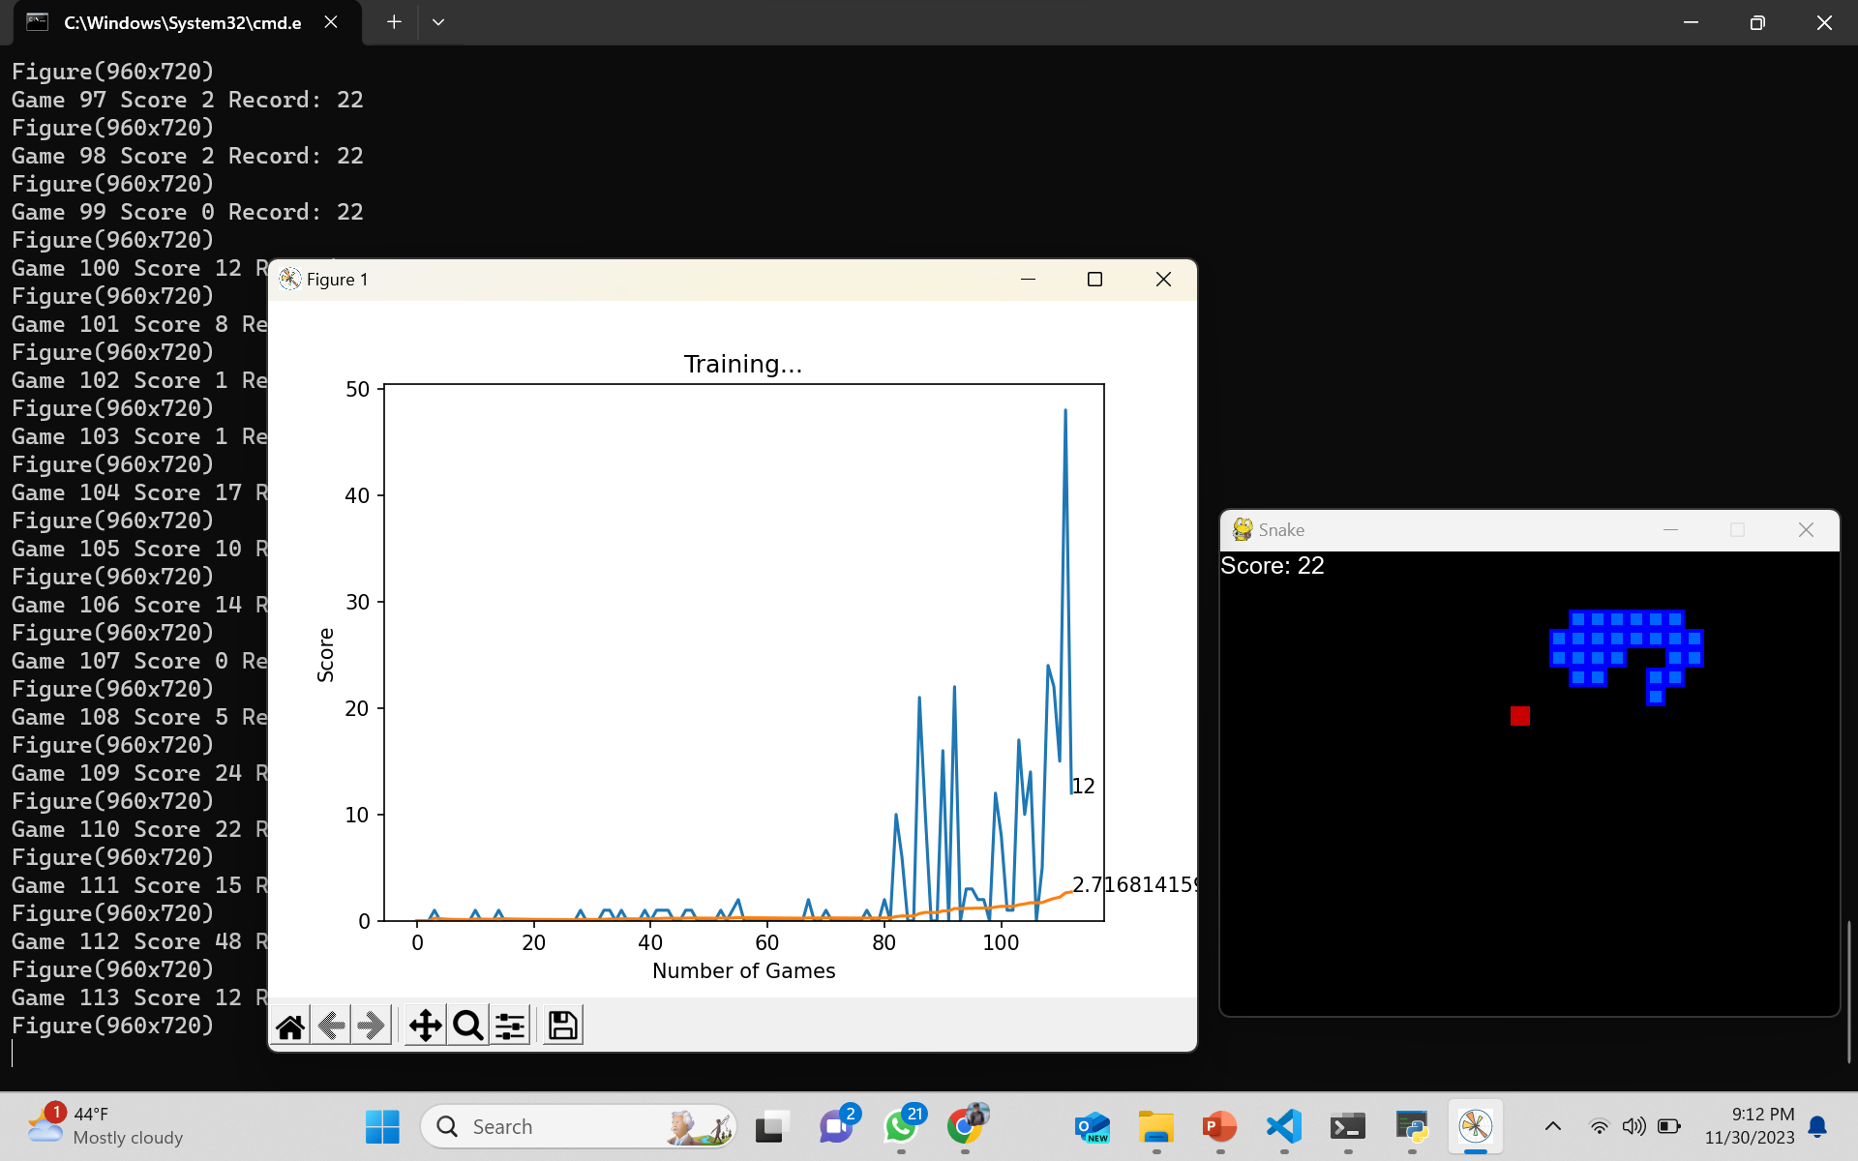
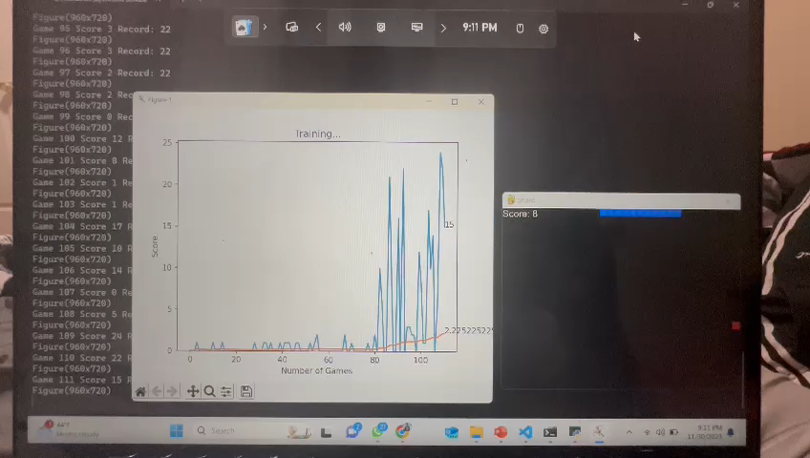
Working model

Slide 12
How Our Snake Game Different ?
In summary, your snake project stands out by incorporating reinforcement learning, deep neural networks, and a specific learning algorithm (Q-learning). These elements contribute to a more adaptive and intelligent snake, capable of learning and improving its gameplay over time, distinguishing it from simpler, rule-based snake games.

Slide 13
References
Picture1:Nokia:https://www.nokia.com/phones/en_int/blog/snake-game-revisited-surprising-facts-and-fascinating-trivi
: https://docs.replit.com/tutorials/python/build-snake-with-pygame

